Slide 1


CURA - HMS
Prof: Henry Wong

Slide 2

AGENDA

Slide 3
AGENDA
Improvements from Professor Feedback
Team Member Roles and Responsibilities
Problem Statement
Project description
Personas
MVP
Technologies
Architecture Diagram
Sprint 2 Recap
Product Backlog
Sprint Backlog
Metrics
Retrospective
Sprint 4

Slide 4

Improvements FROM PROFESSOR FEEDBACK
MVP is enhanced.
Personas were stated with more content.
Architectural diagram is implemented.
Worked on sprint and product backlog along with acceptance criteria and user stories.
Added more test cases and made them precise.
Metrics were calculated as per the completed acceptance criteria and user stories.

Slide 5


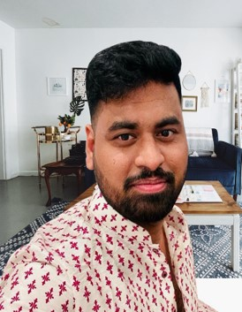
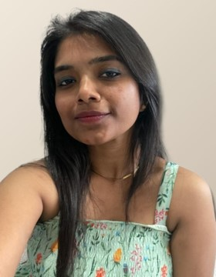
MEET OUR TEAM
SAI TEJA KORIBILLI
BINDU VALISETTY
KULDEEP KALUVALA
MOUNIKA THALLA
SCRUM MASTER
DATA BASE ADMINISTRATOR
UI/UX DEVELOPER
DEVELOPER
PROJECT MANAGER

Slide 6
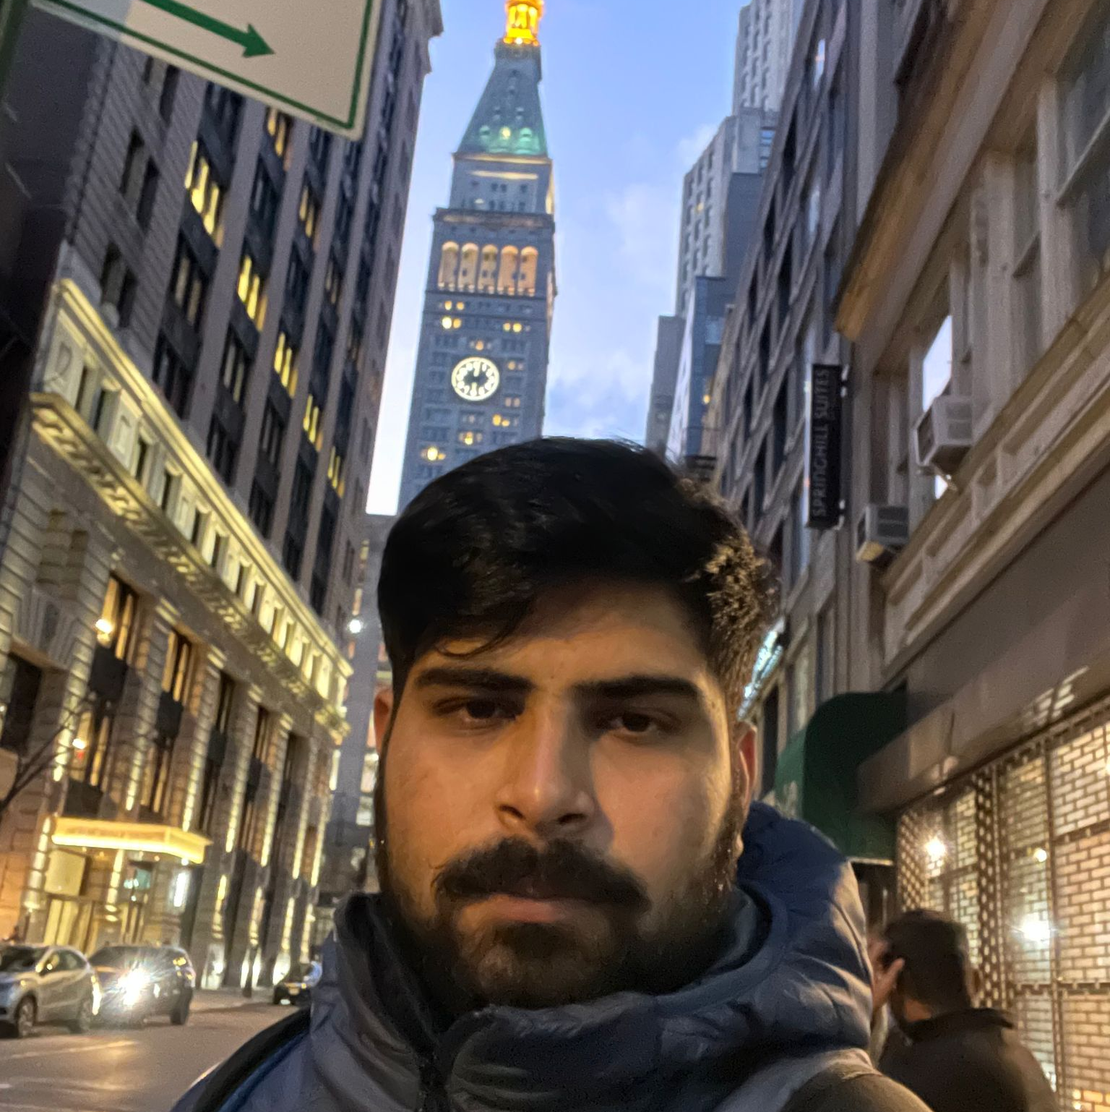


MEET OUR TEAM
SHIVANSH TOMAR
NIKHIL
JIGAR SHAH
DEVELOPER
QUALITY ANALYST ENGINEER
DEVELOPER

Slide 7
PROBLEM STATEMENT
Most hospitals are still facing several challenges with Hospital Management System because some of them are still using manual processes, while those who are using computerized method are also facing the challenge of adjusting to it. Like:
The high cost of software development and deployment.
Complex design in terms of User Interface and User Experience (UI/UX Design)
Fear of data security breach.
Difficulty in migrating from manual processes, because both staff and patients are used to the manual processes and so are unable to speedily cope with the new system.
Lack of IT-friendly medical personnel is also presenting several challenges.
A Huge influx of patients visiting government hospitals makes the process of migrating to automated processes highly difficult. They do not have the patience to wait for registration and data entry and often fail to understand the functioning of automated processes.

Slide 8
PROJECT DESCRIPTION
HMS helps to automate routine tasks, optimize staff coordination, improve communication, distribute the workload, store different types of information, and provide financial and HR management.
A hospital management system (HMS) is a tool that collects data about patients, doctors, staff, hospital administrative details in one software. One of the biggest advantages of developing a hospital management system is that it makes the whole process paperless.
Finances are another essential side of the hospitals. Apart from administrative, operational, and medical services, healthcare units must cope with billing and insurance operations. Integrating a financial system into a medical organization is vital for its sustainable financial performance.

Slide 9


Personas

Slide 10
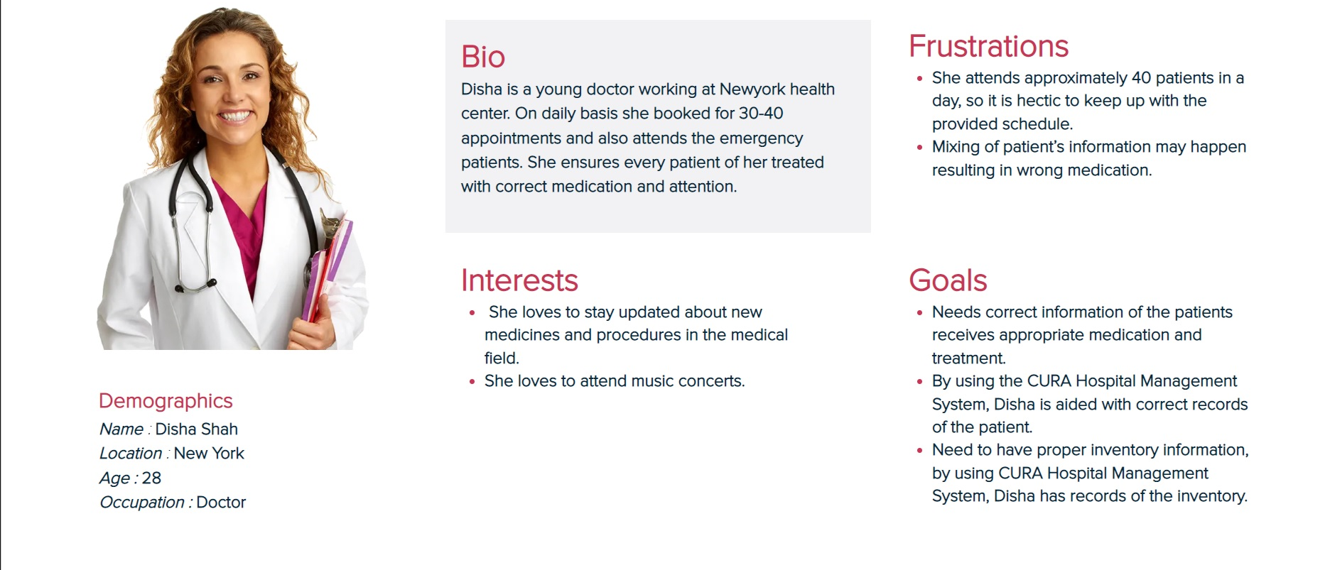
PERSONAS 1

Slide 11
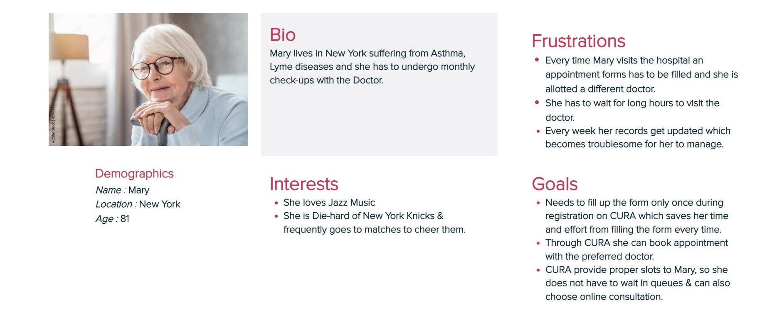
PERSONAS 2

Slide 12
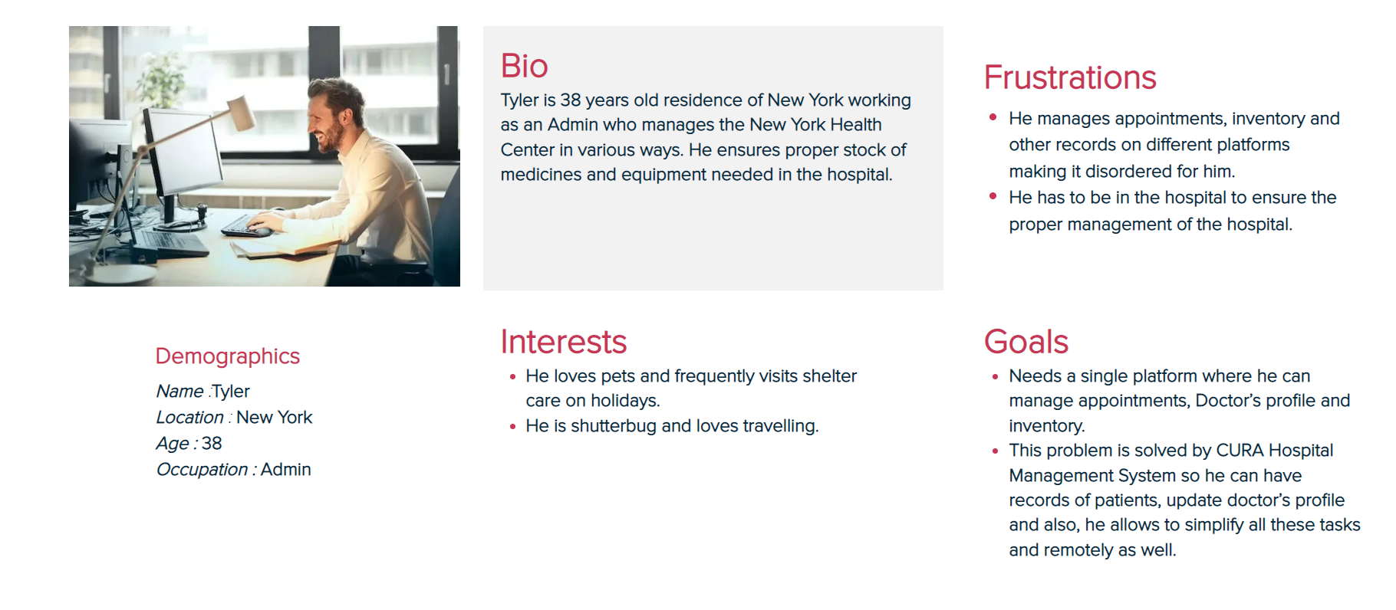
PERSONAS 3

Slide 13

Minimum viable product
REGISTRATION
User can register into CURA through this
LOGIN PAGE
User can log into CURA through this
HOME
User can surf through CURA features through this
User can plan his schedule using this and work accordingly
APPOINTMENTS
SCHEDULING
User can schedule his appointment with doctor through this

Slide 14








technologies
JAVA SCRIPT
CUCUMBER
GIT HUB

Slide 15

Architecture Diagram

Slide 16
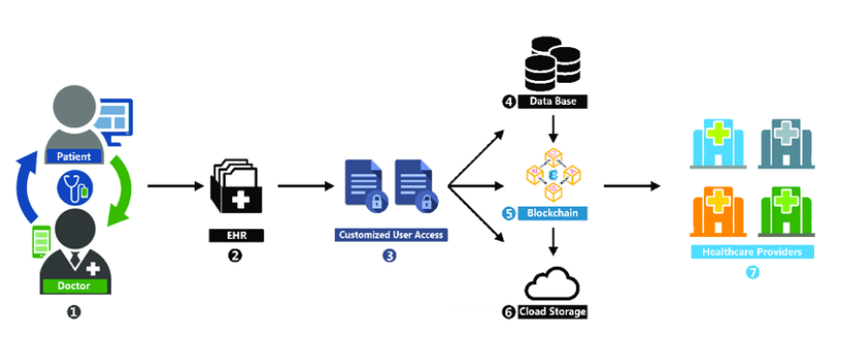

Slide 17
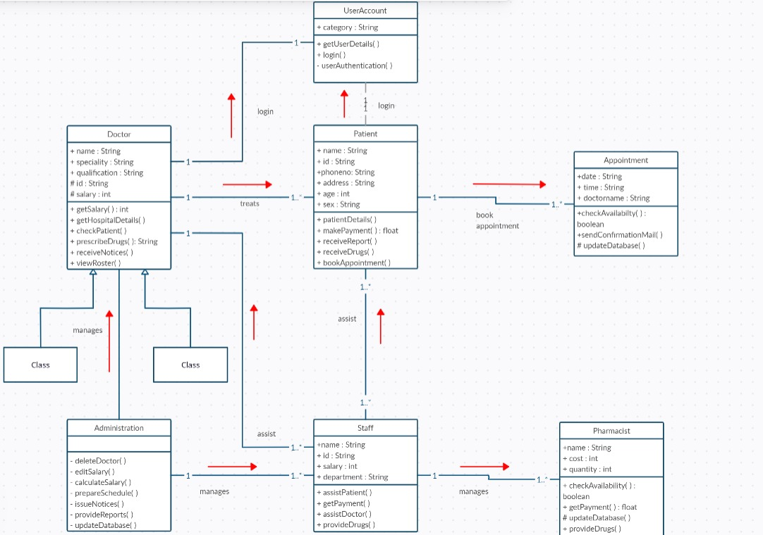
CLASS DIAGRAM of CURA

Slide 18
SPRINT 2 VS SPRINT 3
SPRINT 2
SPRINT 3
REGISTRATION
LOGIN
BASIC UI
SCHEDULE
APPOINTMENTS
PROFILE UPDATION

Slide 19

PRODUCT BACKLOG

Slide 20
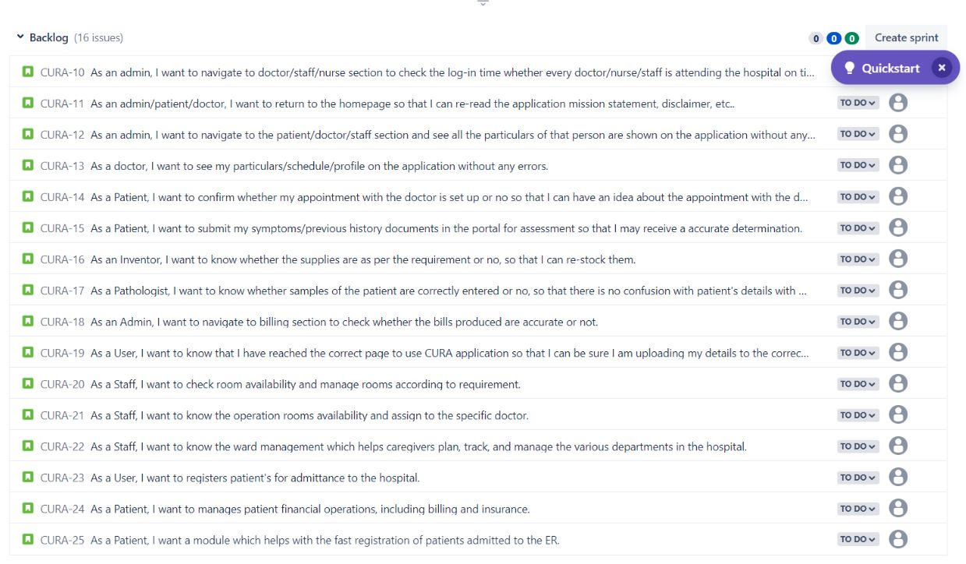

Slide 21
Sprint Backlog
Issue Type | Id | Name
Story | CURA-16 | As an Inventor, I want to know whether the supplies are as per the requirement or no, so that I can re-stock them.
Story | CURA-18 | As an Admin, I want to navigate to the billing section to check whether the bills produced are accurate or not.
Story | CURA-20 | As a Staff, I want to check room availability and manage rooms according to requirements.

Slide 22
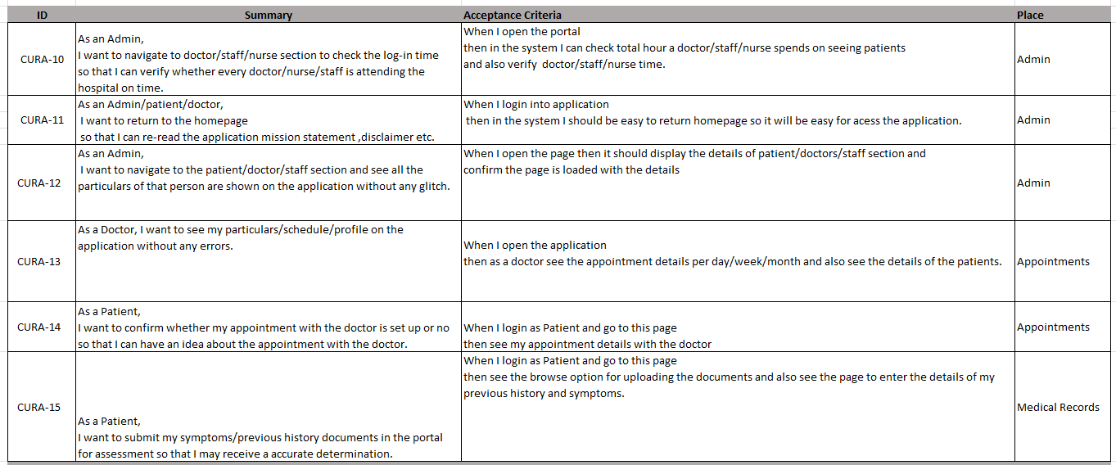
User Stories & Acceptance Criteria

Slide 23
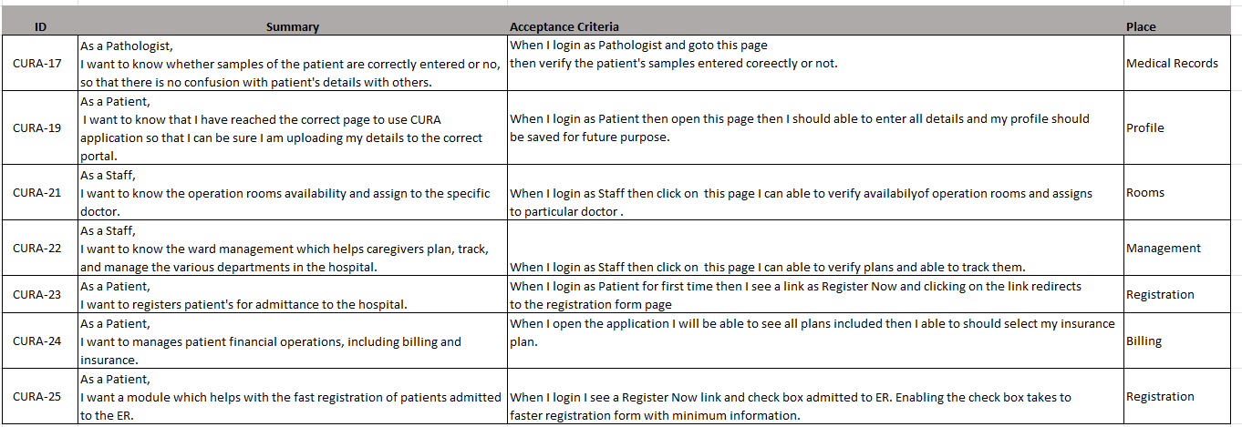
User Stories & Acceptance Criteria

Slide 24
TEST CASES
Test ID | User Story ID | Test Case | Current State | Test Data | steps to follow | Excepted Result | Result
TS-10 | CURA-10 | navigate to doctor section | admin logged into his application | Email:- test@cura.com pwd:- Qura | admin->doctor_section | admin should be able to navigate to doctor section to check their in&out times | PASS
TS-10 | CURA-10 | navigate to staff section | admin logged into his application | Email:- test@cura.com pwd:- Qura | admin->staff_section | admin should be able to navigate to staff section to check their in&out times | PASS
TS-10 | CURA-10 | navigate to nurse section | admin logged into his application | Email:- test@cura.com pwd:- Qura | admin->nurse_section | admin should be able to navigate to nurse section to check their in&out times | PASS
TS-11 | CURA-11 | return to homepage | User login into the application as doctor | Email:- doc1@cura.com pwd:- doc | login->dashboard-> use back option | User should able to return back to homepage | PASS
TS-12 | CURA-12 | loading doctors details page | admin logged into his application | Email:- test@cura.com pwd:- Qura | admin->doctor_section->profile | admin should be able to see all the details of doctor after navigating to doctor section | PASS
TS-12 | CURA-12 | loading staff details page | admin logged into his application | Email:- test@cura.com pwd:- Qura | admin->staff_section->profile | admin should be able to see all the details of staff member after navigating to doctor section | PASS
TS-12 | CURA-12 | loading nurse details page | admin logged into his application | Email:- test@cura.com pwd:- Qura | admin->nurse_section->profile | admin should be able to see all the details of nurse after navigating to doctor section | PASS
TS-13 | CURA -13 | loading appointment details page | User login into the application as a doctor | Email:- aabc@gmail.com pwd:- abc | doctor->schedules | User should be able to see his schedules and patient details | PASS
TS-14 | CURA -14 | loading appointment details page | User login into the application as a patient | Email:- aabc@gmail.com pwd:- abc | patients->appointments | User should be able to see his appointment details | PASS
TS-15 | CURA -15 | Uploading patient datails page | User login into the application as a patient | Email:- aabc@gmail.com pwd:- abc | patients->symtoms | user should be able to upload his previous medical documents and symtoms details | PASS

Slide 25
TEST CASES
TS-16 | CURA -16 | Loading inventory supply details page | User logged into the application as inventor | Email:- aabc@gmail.com pwd:- abc | inventor->supply | User should be able to see all inventory supply details | PASS
TS-17 | CURA -17 | Loading patients test sample data details page | User logged into the application as pathologist | Email:- aabc@gmail.com pwd:- abc | pathologist-> sample test data | User should be able to see all patients test sample data for examining | PASS
TS-18 | CURA -18 | navigate to billing section | User logged into the application as admin | Email:- aabc@gmail.com pwd:- abc | admin->bill | User should be able to navigate to billing section to check billing data accurate or not | PASS
TS-19 | CURA -19 | editing profile data | User logged into the application as patient | Email:- aabc@gmail.com pwd:- abc | patient->profile | User should be able to edit and save his profile information | PASS
TS-20 | CURA -20 | check room availability | User logged into the application as staff | Email:- aabc@gmail.com pwd:- abc | staff->rooms | User should be able see the list of available room details | PASS
TS-21 | CURA -21 | assigning room to the specific doctor. | User logged into the application as staff | Email:- aabc@gmail.com pwd:- abc | staff->rooms->assign | User should be able to assign room to a doctor | PASS
TS-22 | CURA -22 | loading details of members in different departments | User logged into the application as staff | Email:- aabc@gmail.com pwd:- abc | staff->departments->profile | User should the able see different department members details | PASS
TS-24 | CURA -24 | Selecting insurance plan | User logged into the application as patient | Email:- aabc@gmail.com pwd:- abc | patient->insurance plan | User should be able to see all available insurance plans and select one of them | PASS
TS-25 | CURA -25 | loading quick registration form | User logged into the application as patient | Email:- aabc@gmail.com pwd:- abc | patient->check box->min registration form | User should be able to click check box and should taken to minimal information registration form | PASS

Slide 26
Stories
Completed
Incomplete
As a patient, I want to register and sign in successfully, so that I can store all my account details.
As a patient, I want to book an appointment.
As a doctor, I want to go-through the appointments list.
As an Inventor, I want to know whether the supplies are as per the requirement or no, so that I can re-stock them.
As an Admin, I want to navigate to the billing section to check whether the bills produced are accurate or not.
As a Staff, I want to check room availability and manage rooms according to requirements.

Slide 27
METRICS

Slide 28
Team Velocity

Slide 29
Team History Velocity

Slide 30
Burndown chart

Slide 31
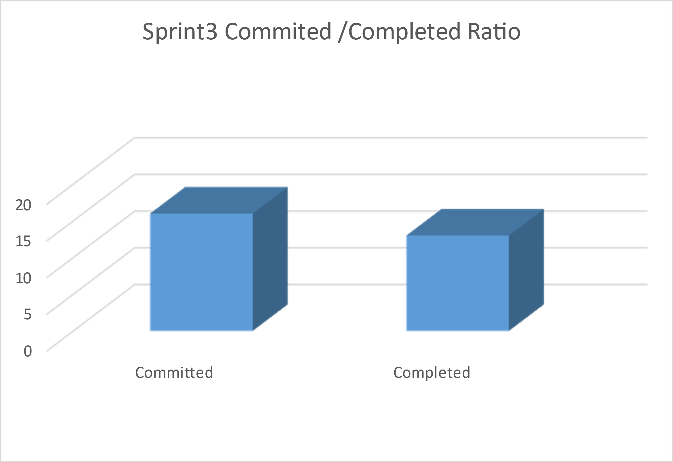
COMMITTED/ COMPLETED
RATIO

Slide 32
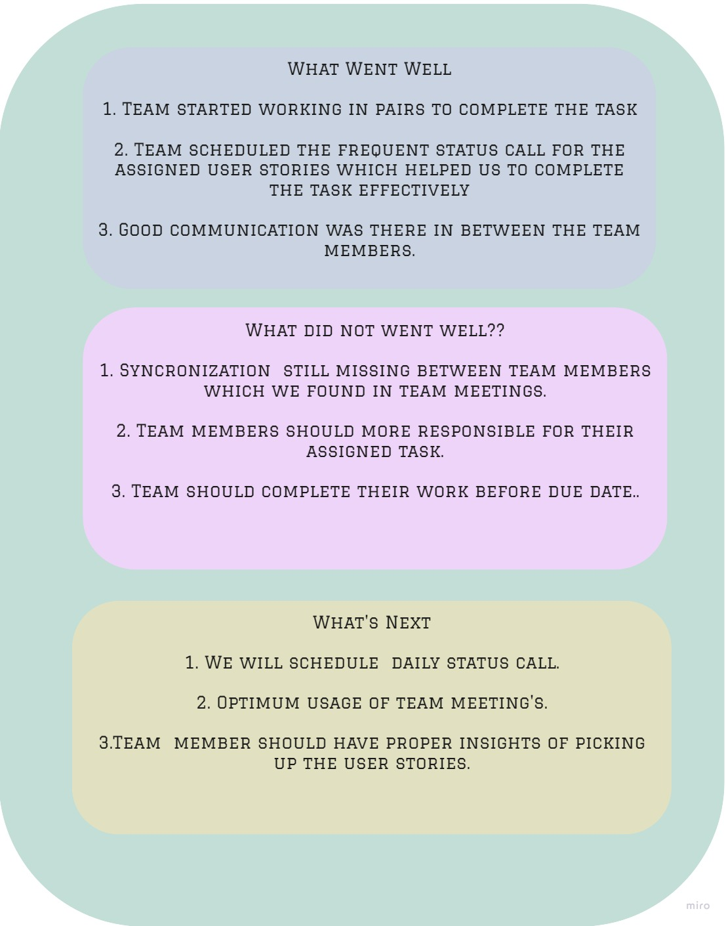
RETROSPECTIVES

Slide 33
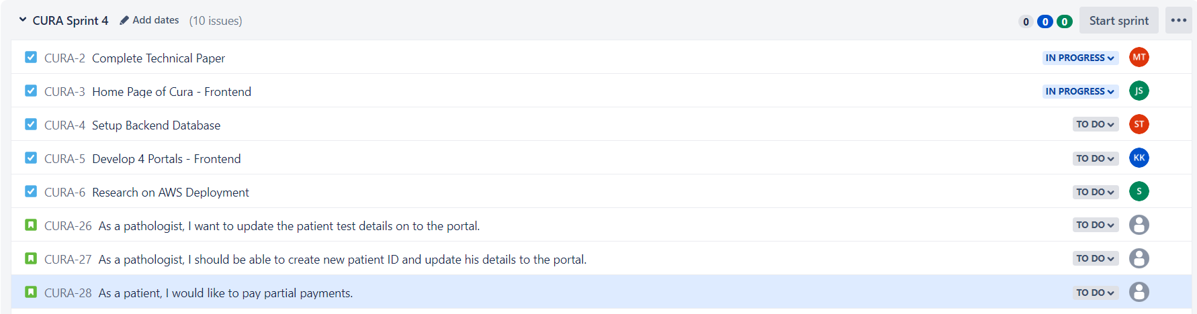
SPRINT 4 - STORIES PLANNED AND COMMITTED

Slide 34
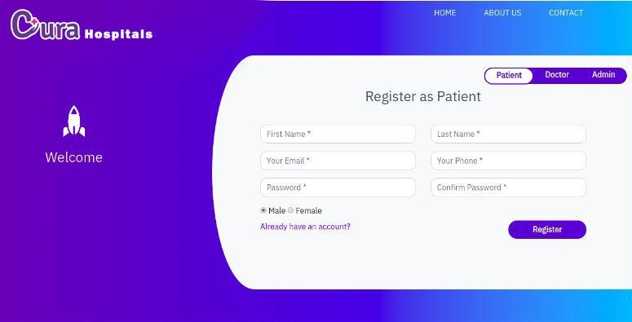
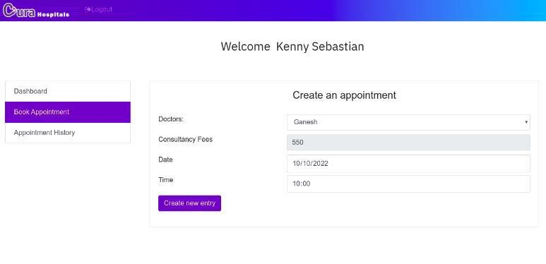
Application Screenshot

Slide 35


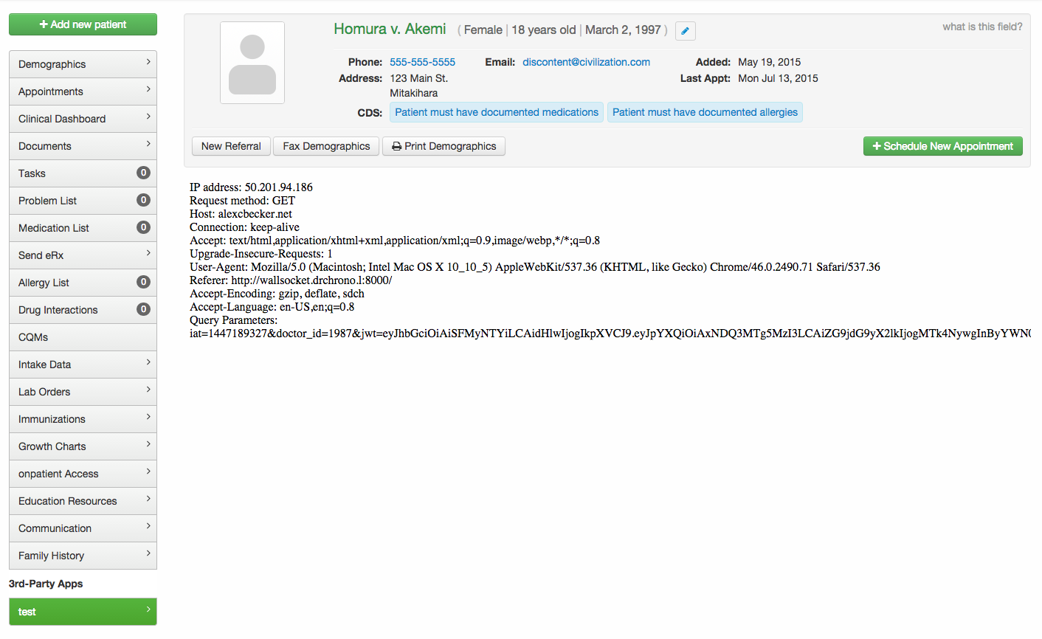
Api used

Slide 36
GITHUB LINK
https://github.com/SaiTejjj/HMS/wiki/CURA---HMS

Slide 37
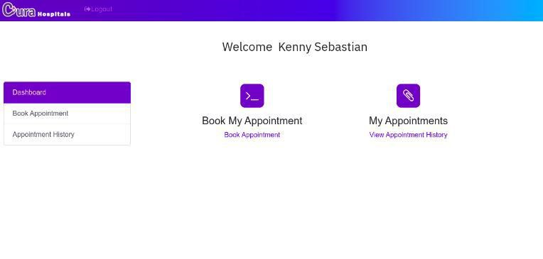
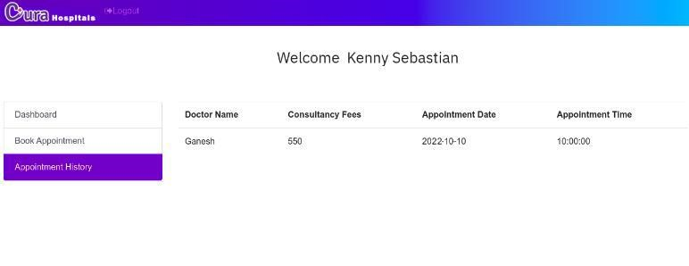
Live application demo

Slide 38

THANK YOU
Sai Teja Koribilli
Jigar Shah
Mounika Thalla
Kuldeep Raj
Bindu Valishetti
Nikhil
Shivansh Tomar

